Slide 1
Capstone Project
"Comprehensive Analysis of Fortune 1000 Companies: Unveiling Insights from Revenue, Profit Change, and Workforce Dynamics"
Members: Sania Bandekar, Brendan Dishion & Nathan Pham

Slide 2
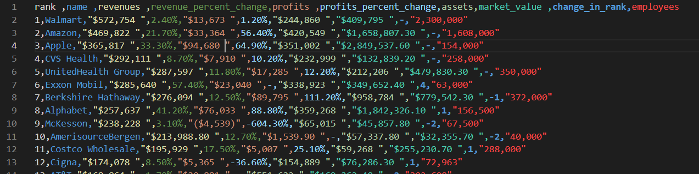
Objective
The project aims to perform a comprehensive analysis of the "Fortune 1000 Companies by Revenue.csv" dataset using custom Bash scripts. The initial phase involves extracting metadata, including the total number of entries, data types of each column, column headers, count of missing values, unique values per column, and the minimum-maximum value ranges in specified columns. Subsequently, the project delves into deriving nontrivial insights by calculating correlations. Specifically, it explores the relationship between the percentage change in profits and market value, the Pearson correlation coefficient between revenues and the number of employees, and the correlation between revenues and profits for the listed companies. The ultimate goal is to provide users with a deeper understanding of the dataset's characteristics and interdependencies, facilitating informed decision-making and data-driven insights.
https://raw.githubusercontent.com/nghiapham1026/cs131/main/MiniProjectGroup10/data/Fortune%201000%20Companies%20by%20Revenue.csv
Dataset-

Slide 3
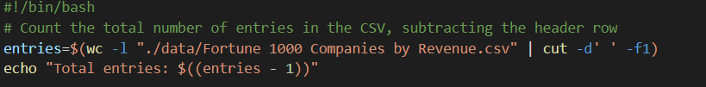
Metadata #1
Idea of Script: To count the total number of lines in the "Fortune 1000 Companies by Revenue.csv" file, which represents the total number of entries, and then subtract one to exclude the header row.
Execution Steps:
Assign the result of wc -l (word count for lines) command to the variable entries. This command counts all lines in the CSV file.
Use cut -d' ' -f1 to extract just the number part of the wc -l output.

Slide 4
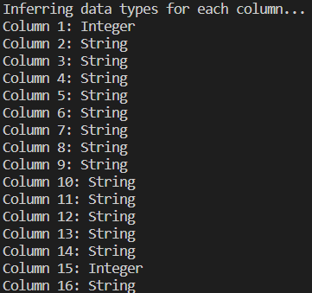
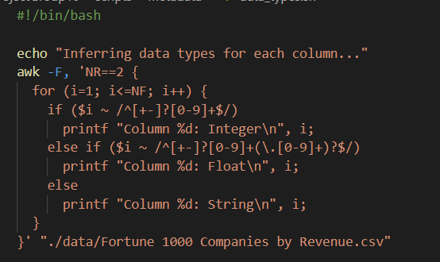
Metadata #2
Idea of Script: To infer the data types of each column in the "Fortune 1000 Companies by Revenue.csv" by examining the contents of the second row (assuming the first row is the header).
Execution Details:
The script uses awk to analyze the file.
It sets the field separator to a comma (,), as it's dealing with a CSV file.
NR==2 instructs awk to only consider the second row of the file.
The for loop iterates over each field ($i) in the row.
The if and else if statements use regular expressions to test if the field is an integer, a float, or neither.

Slide 5
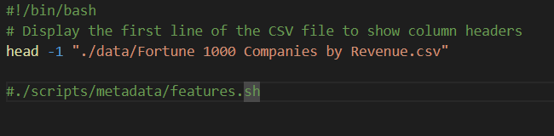
Metadata #3
Idea of Script: To extract and display the column headers from the "Fortune 1000 Companies by Revenue.csv" file, which indicate the features included in the dataset.
Execution Details:
The script uses the head command to output the first line of the CSV file.
-1 option tells head to select only the first line, which typically contains the column names in a CSV file.

Slide 6
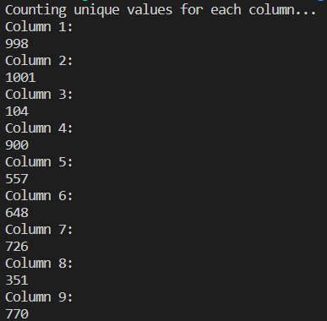
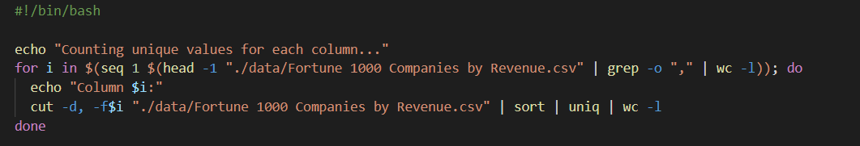
Metadata #4
Idea of Script: To count the number of unique values present in each column of the "Fortune 1000 Companies by Revenue.csv" file.
Execution Details:
It uses a for loop to iterate over each column in the CSV file.
seq generates a sequence of numbers from 1 to the number of columns, which is determined by counting the commas in the header row.
For each column, cut extracts the column's data, sort arranges the lines, uniq filters out duplicate lines, and wc -l counts the remaining unique lines.

Slide 7
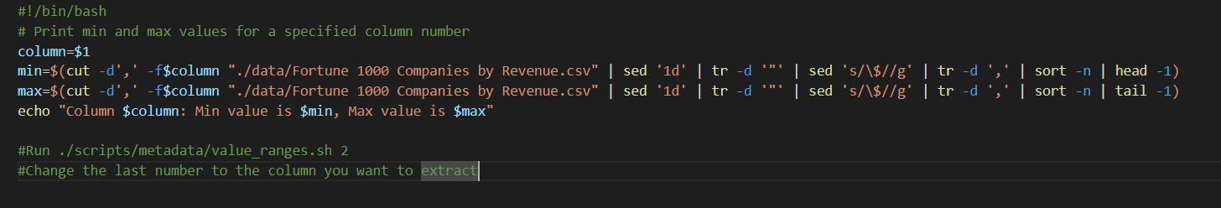
Metadata #5
Idea of Script: This script is designed to find the minimum and maximum values in a specified column of the "Fortune 1000 Companies by Revenue.csv" file.
Execution Details:
cut is used to extract the specified column's data.
sed '1d' removes the header row from the output.
tr -d '"' removes any double-quote characters that may be present.
sed 's/\$//g' strips out dollar sign characters.
tr -d ',' removes commas, which are often used as thousand separators in numbers.
sort -n sorts the numbers in ascending order.
head -1 and tail -1 are used to get the minimum and maximum values, respectively.

Slide 8
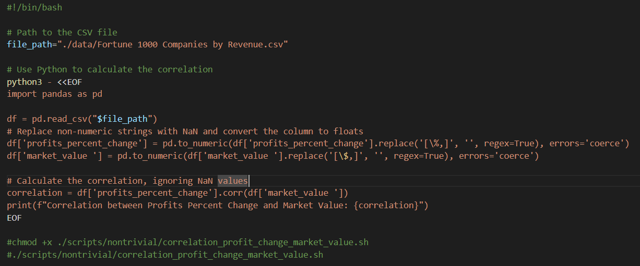
Nontrivial #1
Idea of Script: To calculate the correlation coefficient between the percent change in profits and the market value of companies listed in the "Fortune 1000 Companies by Revenue.csv" file.
Execution Details:
The pd.to_numeric function is used to convert the 'profits_percent_change' and 'market_value' columns to numeric types, with non-numeric strings converted to NaN (using errors='coerce' to avoid conversion errors).
regex=True is used within the replace function to apply regular expressions for removing percentage signs and currency symbols.
The corr method from pandas is used to calculate the Pearson correlation coefficient between the two columns, which measures the linear relationship between them.

Slide 9
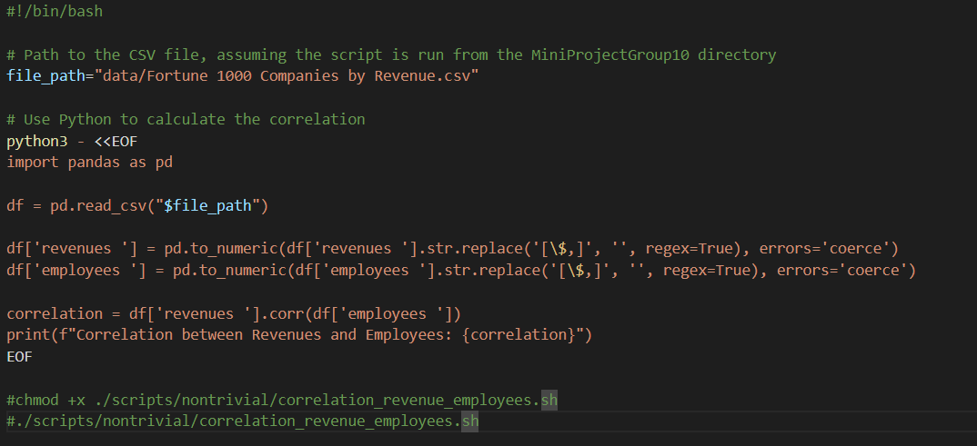
Nontrivial #2
Idea of Script: To find the correlation between the revenues and the number of employees of companies listed in the "Fortune 1000 Companies by Revenue.csv" file.
Execution Details:
The revenues and employees columns are cleaned using str.replace to remove commas and dollar signs, which are common in currency representations.
The pd.to_numeric function with errors='coerce' parameter converts the cleaned string values to numeric, turning non-numeric strings into NaNs (useful for handling missing data).
The corr function from pandas is used to compute the Pearson correlation coefficient between the revenues and employees columns, providing a measure of the linear relationship between the two variables.

Slide 10
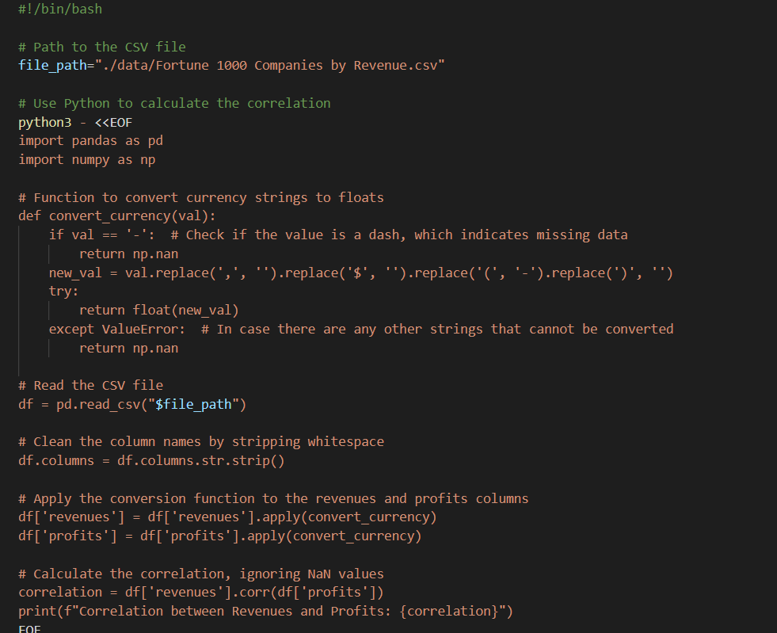
Nontrivial #3

Slide 11
Nontrivial #3
Idea of Script: To calculate the correlation between company revenues and profits from the "Fortune 1000 Companies by Revenue.csv" file.
Execution Details:
The convert_currency function is defined to convert currency-formatted strings (including handling of missing values represented by '-') to float values.
Column names are cleaned of any leading/trailing whitespace to avoid issues with column name mismatches.
The convert_currency function is applied to the 'revenues' and 'profits' columns to clean and convert the data to numeric format, handling missing values by converting them to np.nan.
The Pearson correlation coefficient between the 'revenues' and 'profits' columns is calculated using the pandas corr method.

Slide 12
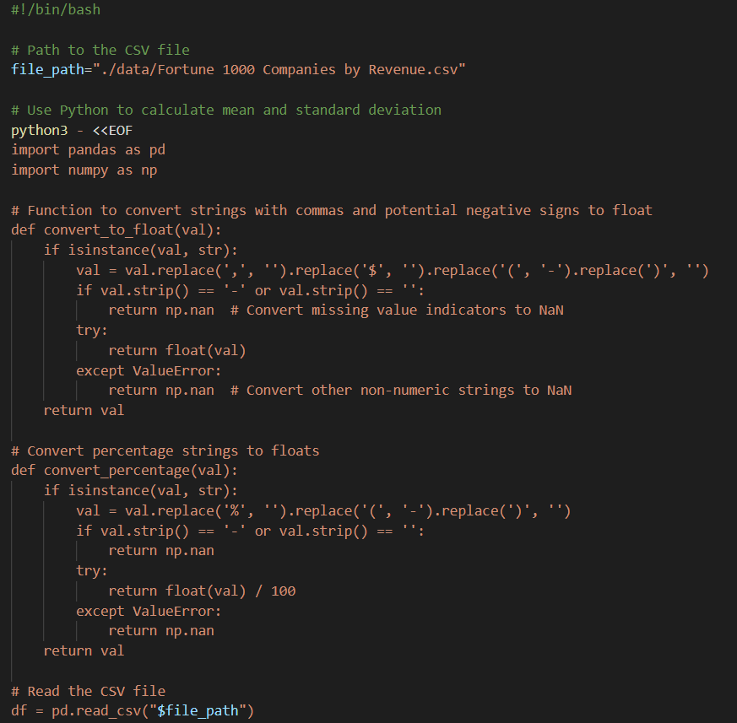
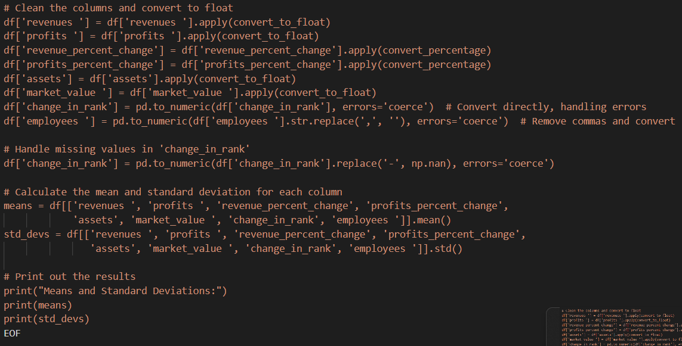
Nontrivial #4

Slide 13
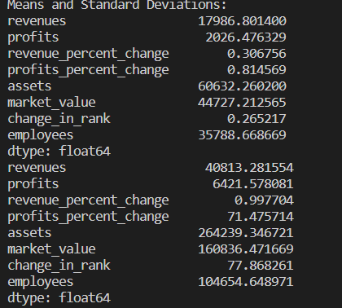
Nontrivial #4
Idea of Script: The script aims to compute the mean (average) and standard deviation (a measure of the amount of variation or dispersion) for selected numerical columns in the "Fortune 1000 Companies by Revenue.csv" file.
Execution Details:
Defines two functions in Python to handle currency and percentage conversion:
convert_to_float cleans and converts currency-formatted strings to float, accounting for missing or special characters.
convert_percentage converts percentage strings into float values, handling special cases and missing values.
Applies the conversion functions to appropriate columns to standardize the data for numerical operations.
Calculates the mean and standard deviation for the cleaned columns using pandas methods.

Slide 14
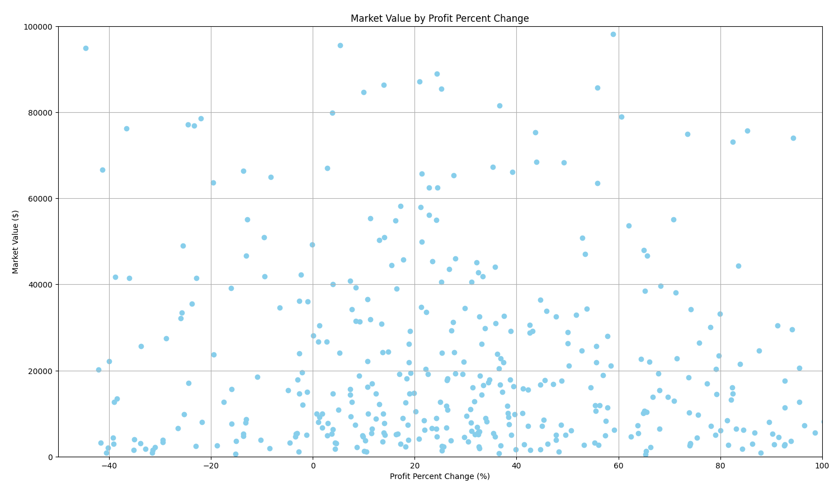
Market Value ($) vs Profit Change (%) - Plot 1

Slide 15
Input file created using linux commands - Plot 1
awk 'BEGIN {FPAT = "\"[^\"]+\"|[^,]+"; OFS=","} {gsub(/\"/,"",$6); gsub(/\"/,"",$8); print $6, $8}' "Fortune 1000 Companies by Revenue.csv" > processed.csv
This command invokes awk
FPAT tells awk how to recognize fields in the input
Sets regular expression that matches either a quote or sequence of characters
`”[^\”]+”` - quote followed by any characters except a quote, followed by a quote
`[^,]+` - sequence of characters that don’t include comma
OFS=”,” - sets output field separator to comma
gsub(/\"/,"",$6) - replaces all quotation symbols in 8th column
gsub(/\"/,"",$8) - replaces all quotation symbols in 8th column
print $6, $8 - prints 6th and 8th columns
Output is directed to processed.csv

Slide 16
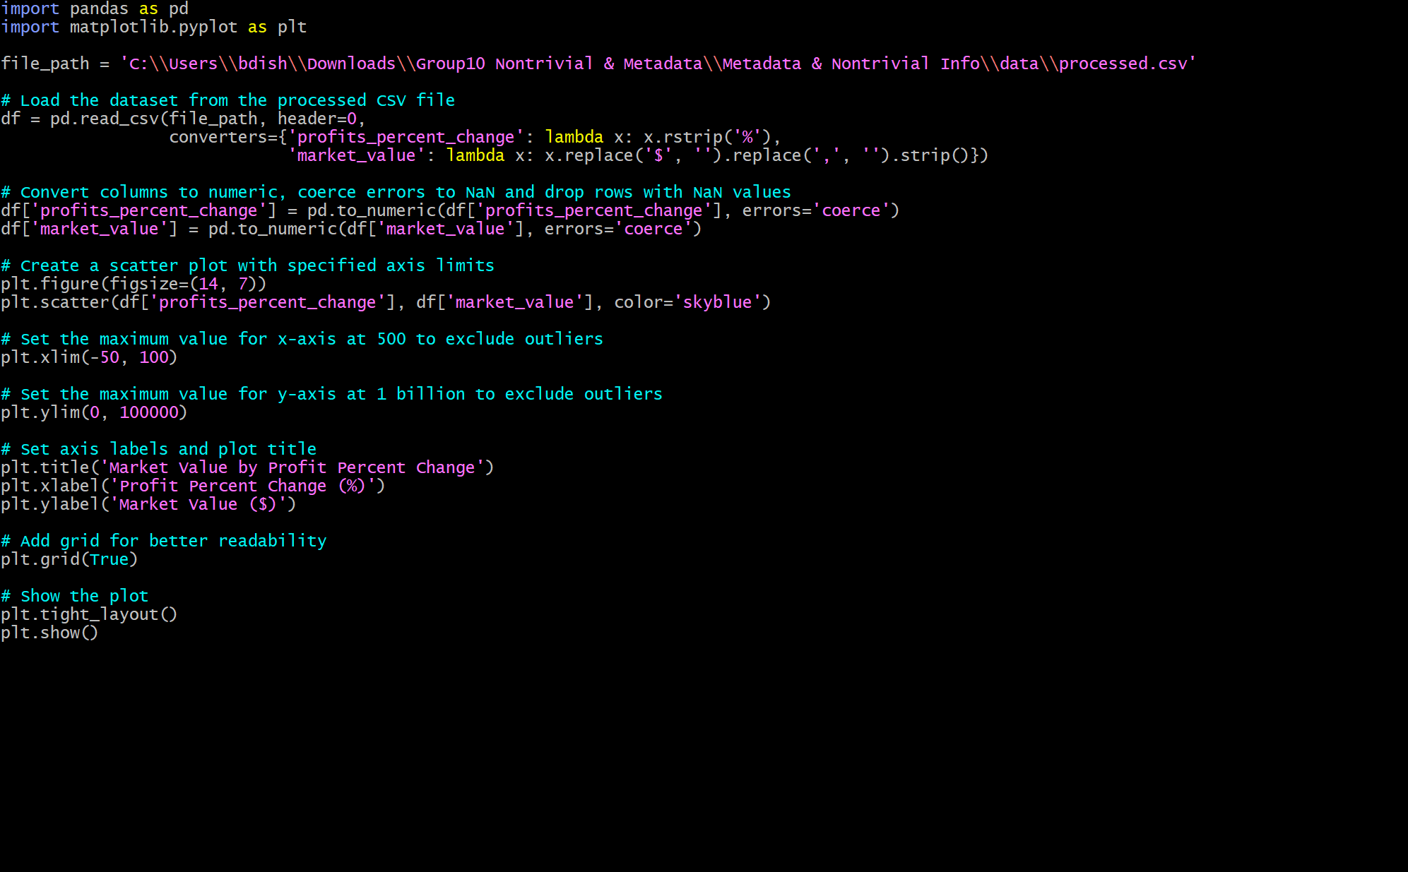
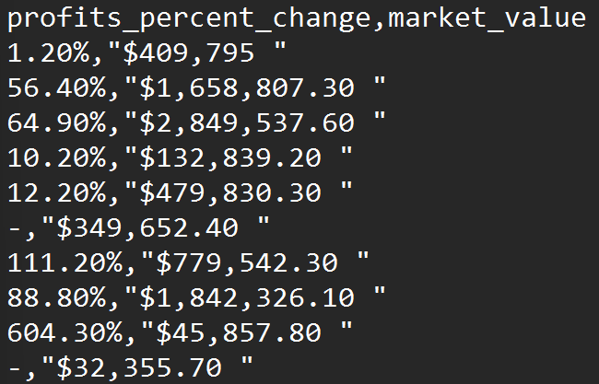
Script for Market Value vs. Profit Change - Plot 1
Top 10 columns/rows from processed.csv, the file continues for 990 other entries. This only shows the first 10 entries for the processed.csv file that we created using linux commands
Python script named visualize_data.py plots the profits_percent_change & the market value using a scatter plot. The script reads in the path to processed.csv, which was the file we created using Linux commands. It uses the pandas and matplotlib libraries to visualize this data.

Slide 17
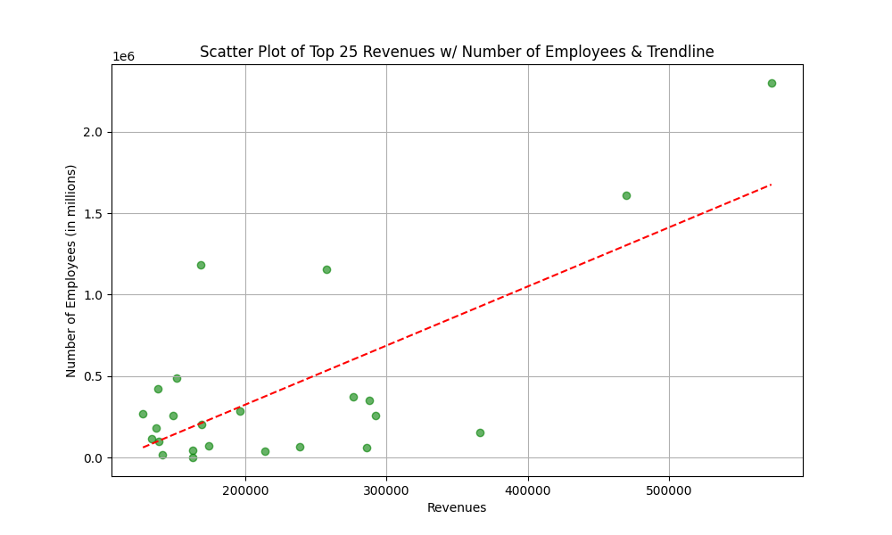
Visualization of Revenue vs. # of Employees for Top 25 Fortune Companies - Plot 2

Slide 18
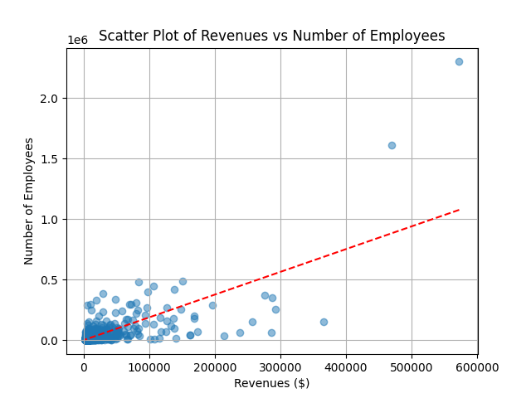
Visualization of Fortune 1000 Companies based on # of Employees and Revenue ($) - Plot 2

Slide 19
Input files created using linux commands - Plot 2
awk -F',"' '{out=""; for(i=2; i<=NF; i++){gsub(/^"|"$/,"",$i); out=out (i>2?",":"") $i} print substr(out,2)}' 'Fortune 1000 Companies by Revenue.csv' > 'new_file.csv'
Initializes awk and sets field separator to `,”` meaning that it will split each line of the input field into fields wherever there is a comma followed by a quote
‘{out=””; for(i=2; i<=NF; i++)` - starts a block of code where ‘out’ is initialized as empty string, then loops from the 2nd to last field
`gsub(/^”|”$/,””,$i); - gsub performs global substitution on each field replacing leading and trailing quotes with nothing
`out=out (i>2?”,”:””) $i - concatenates current field to `out` variable
`print substr(out,2)} - prints out string contained in var `out` starting from second character
tr -d '"' < 'new_file.csv' > 'cleaned_file.csv'
Trims remaining quotes from new_file.csv and redirects to cleaned_file.csv
cut -d',' -f1,2,12,13,14 cleaned_file.csv > cleaned_file1.csv
Cuts specified fields and redirects output to cleaned_file1.csv
head -n 25 cleaned_file1.csv > top_employees_revenue.csv
Extracts the top 25 entries from the cleaned_file1.csv and redirects them to top_employees_revenue.csv

Slide 20
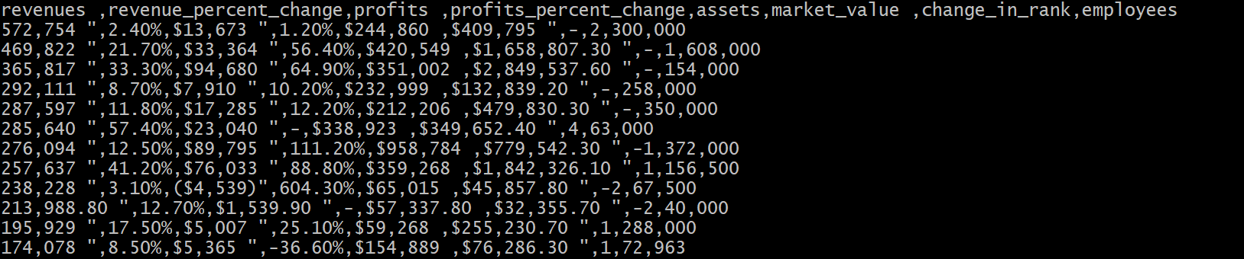
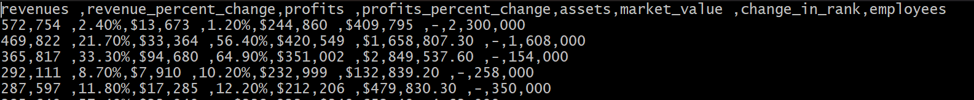
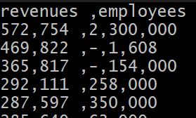
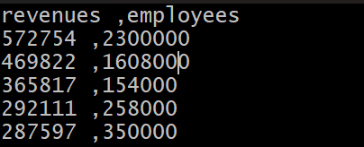
Files created using Linux commands - Plot 2
Top 5 Columns/Rows from new_file.csv
Top 5 Columns/Rows from cleaned_file.csv
Top 5 for cleaned_file1.csv
Top 5 for top_employees_revenue.csv

Slide 21
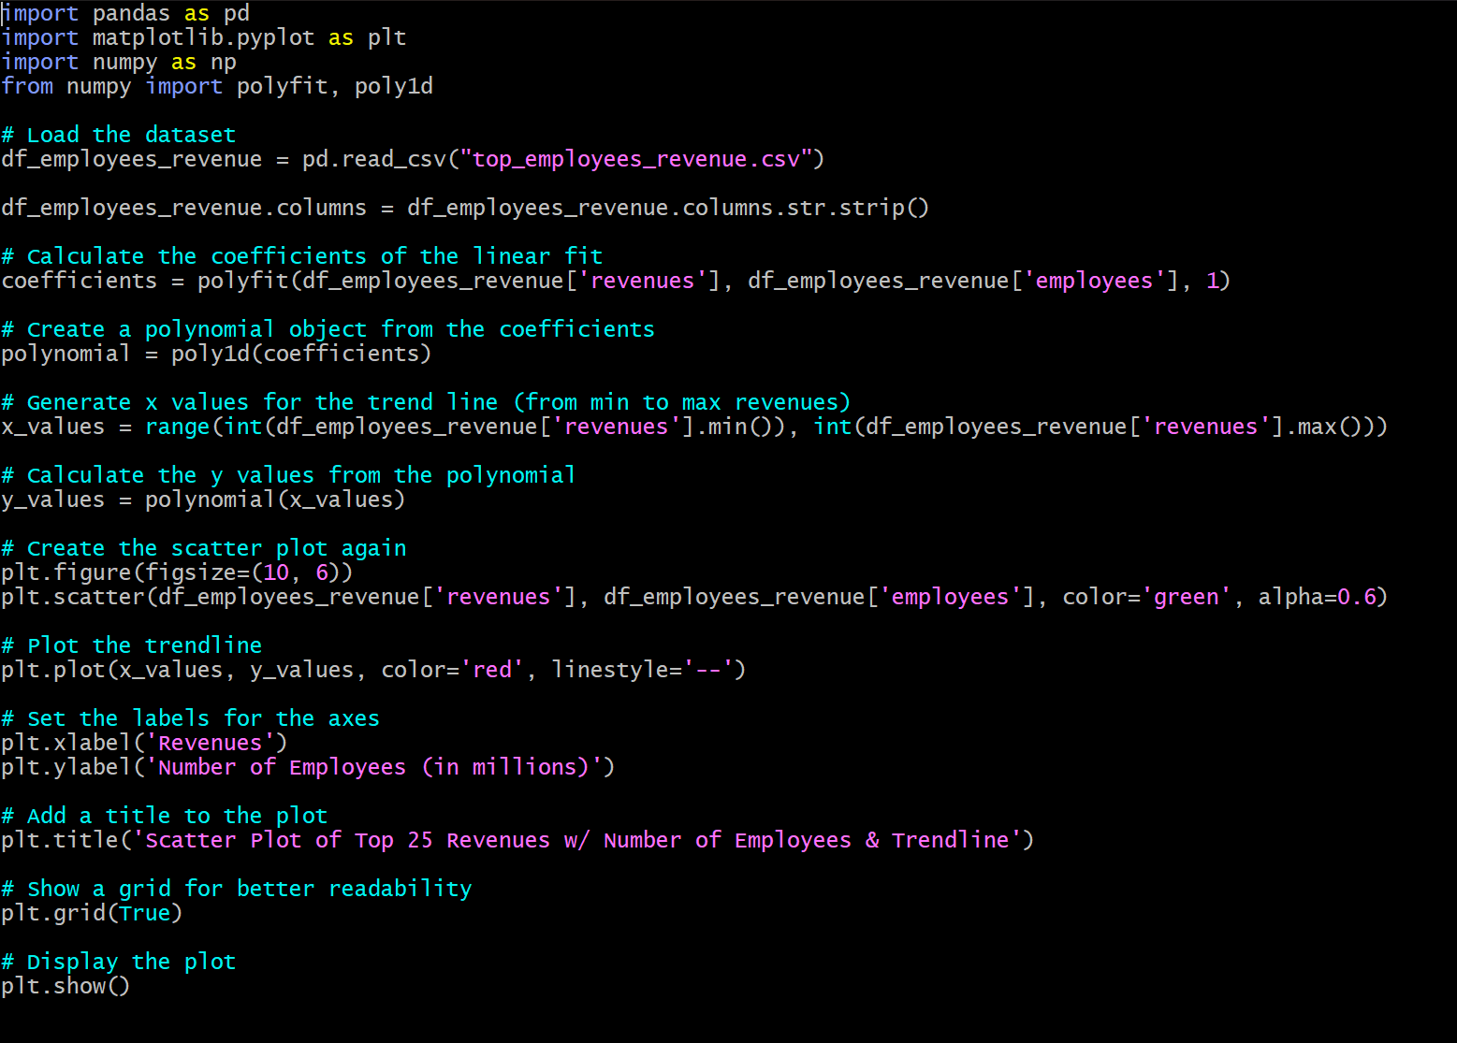
Script for # of Employees and Revenue - Plot 2
This script reads in the linux created file “top_employees_revenue.csv”
Uses pandas, matplotlib, numpy libraries
Imports polyfit and poly1d to create a linear fit for the data visualization
This script ultimately visualizes the data for revenue vs the number of employees for each company

Slide 22
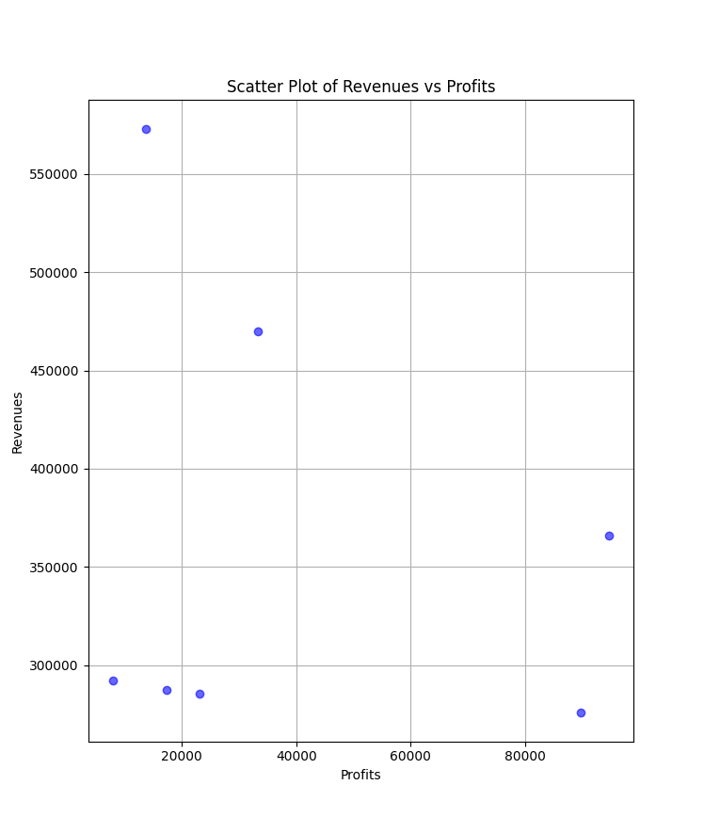
Visualization of Revenue and Profit for Top 7 Fortune Companies - Plot 3

Slide 23
Input File Created using Linux commands - Plot 3
cut -d',' -f3,4,6,7 'Fortune 1000 Companies by Revenue.csv' > revenue_profits.csv
This command cuts fields 3,4,6 and 7, the delimiter is a comma, redirects this output to revenue_profits.csv
head -n 8 revenue_profits.csv > top_revenue_profits.csv
Extracts the top 8 columns for revenue and profit column, redirects output to top_revenuePprofits.csv
sed 's/"//g; s/\$//g' top_revenue_profits.csv > cleaned_top_revenue_profits.csv
sed ‘s/”//g - tells sed to search for double quote chars and replace them with nothing, s is substitution command, g is global
s/\$//g - tells sed to search for $ and replace with nothing, / before $ is an escape character

Slide 24
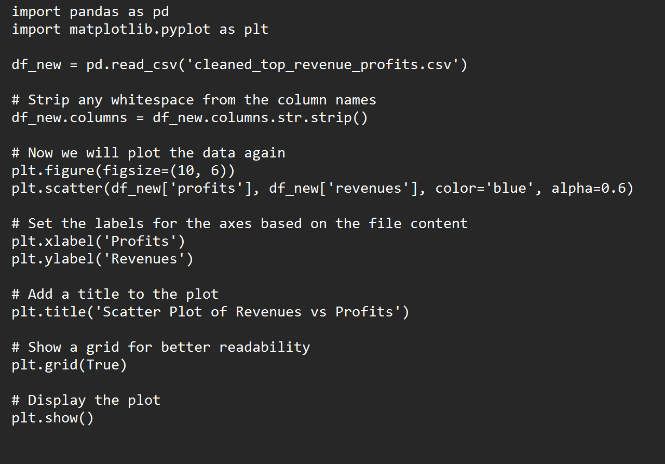
Script for Revenue vs Profits - Plot 3
Reads in linux-created file ‘cleaned_top_revenue_profits.csv’
Uses pandas and matplotlib libraries to create graph
This script creates a scatter plot that visualizes the profits vs revenue for the top Fortune companies

